Slide 1
Options Strategy Back testing on Bank Nifty (2022–2024)

Slide 2
Project Workflow
Raw NSE Data
Merge Data
Backtesting Engine
Performance Metrics
Market Regime Analysis
Strategy Comparison
Charts Generation

Slide 3
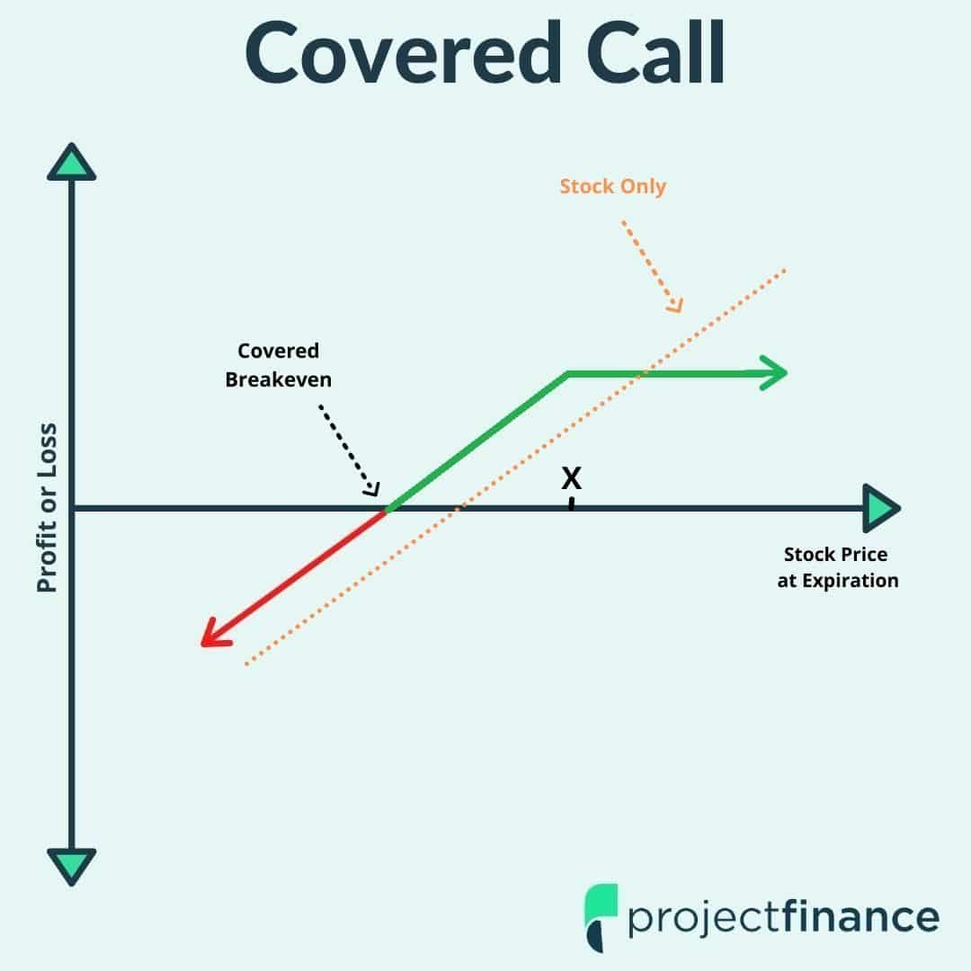
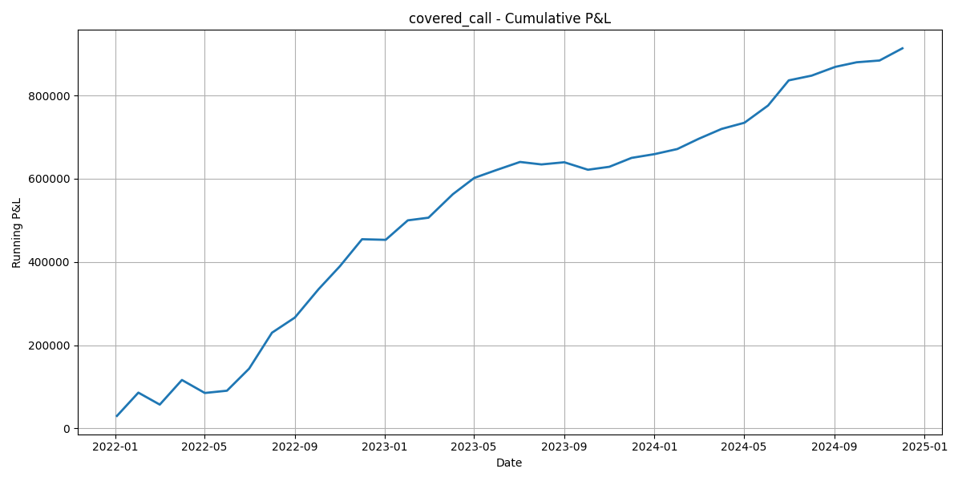
Covered Call
Performance Metric | Value
Total P&L | ₹913,530.50
Win Rate | 86.11%
Maximum Drawdown | -₹31,212.50
Sharpe Ratio | 3.18
Average Monthly Return | ₹25,375.85
Best suited for moderately bullish markets with relatively stable returns.

Slide 4
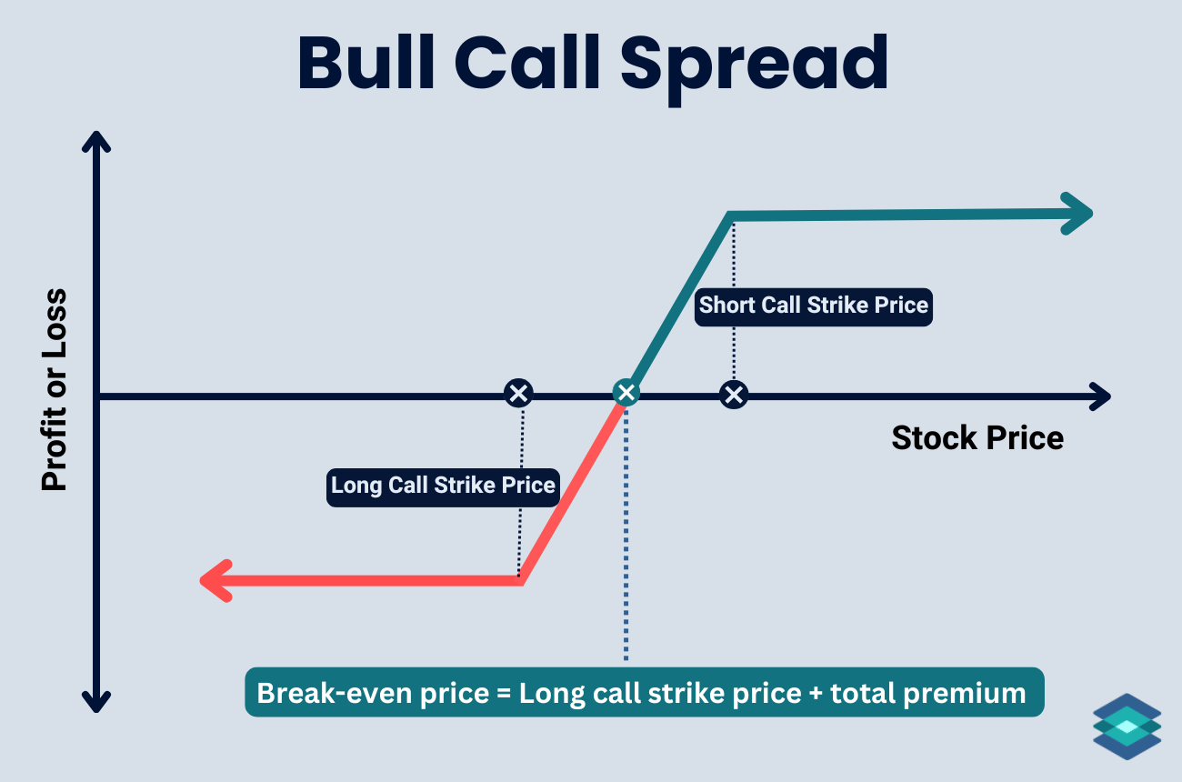
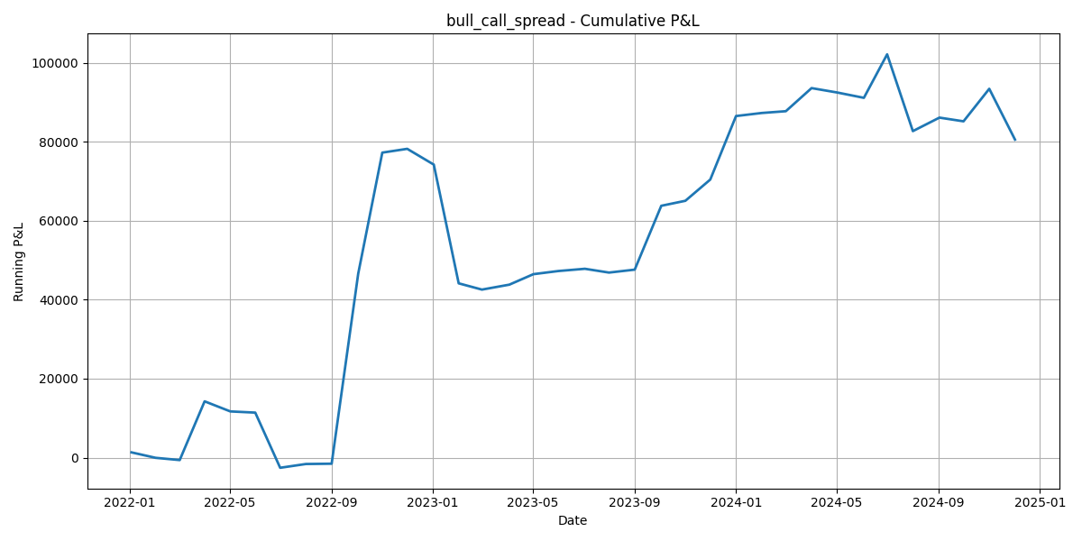
Bull Call Spread
Performance Metric | Value
Total P&L | ₹80,552.25
Win Rate | 61.11%
Maximum Drawdown | -₹35,657.50
Sharpe Ratio | 0.60
Average Monthly Return | ₹2,237.56
Generates limited-risk profits during bullish trends.

Slide 5
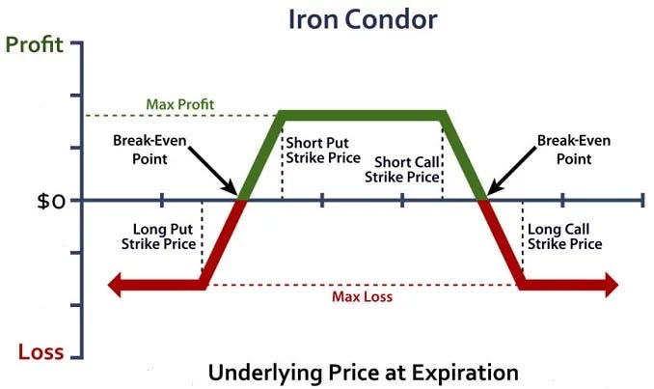
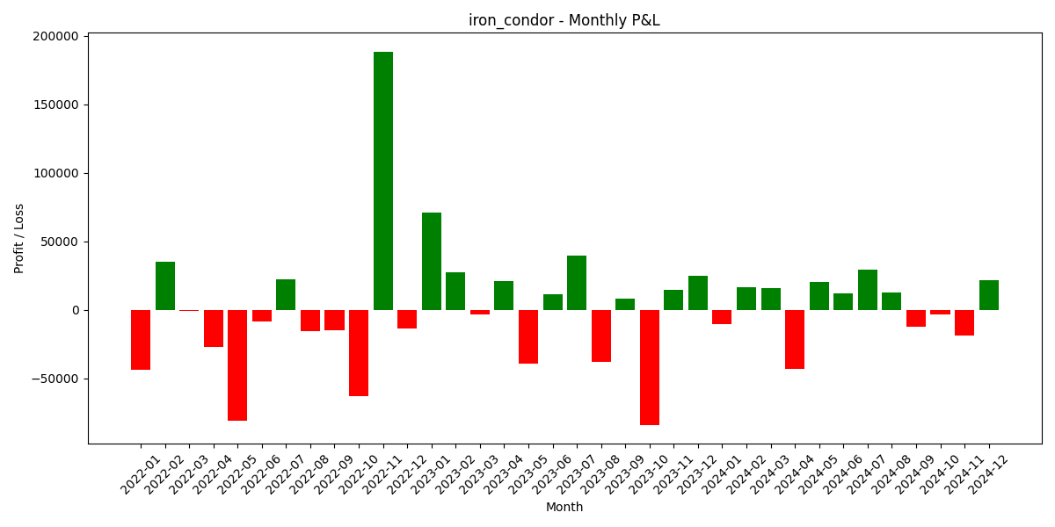
Iron Condor
Performance Metric | Value
Total P&L | ₹66,716.25
Win Rate | 52.14%
Maximum Drawdown | -₹243,171.25
Sharpe Ratio | 0.07
Average Monthly Return | ₹1,853.23
Performs best in sideways markets with low volatility.

Slide 6
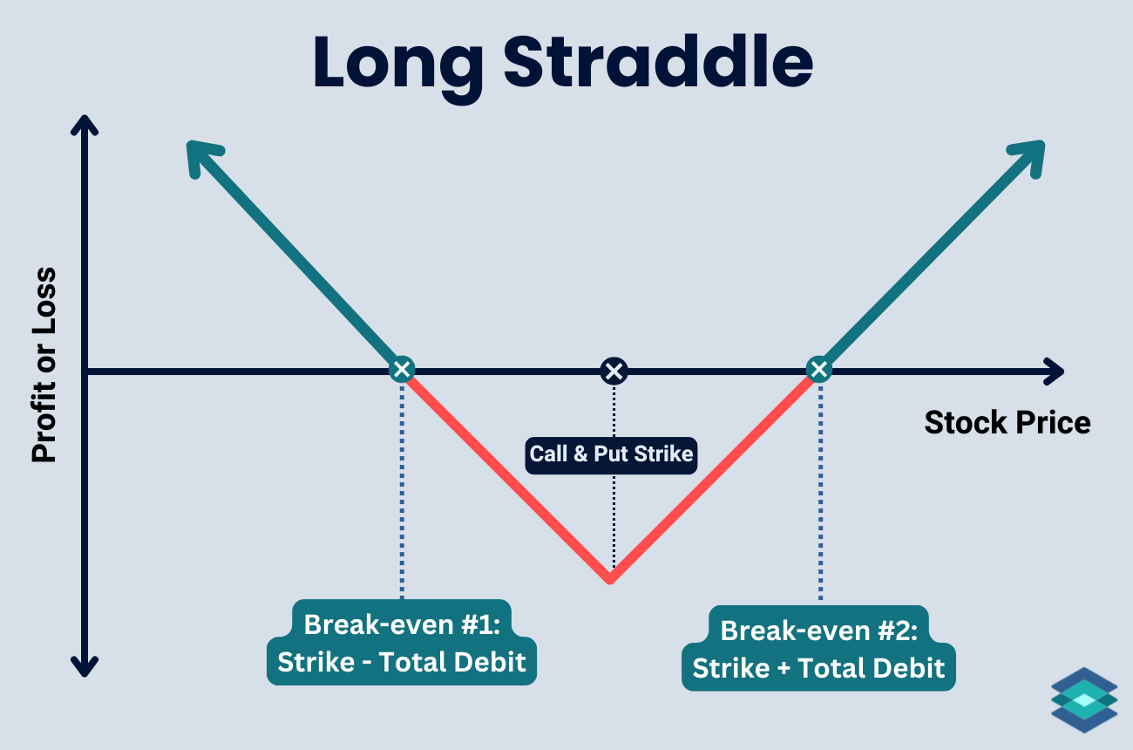
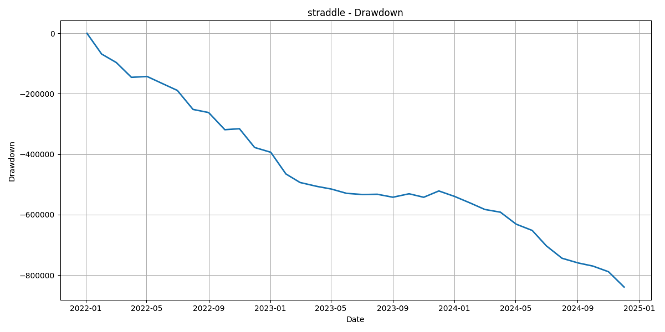
Long Straddle
Performance Metric | Value
Total P&L | -₹848,257.25
Win Rate | 13.89%
Maximum Drawdown | -₹839,718.50
Sharpe Ratio | -3.55
Average Monthly Return | -₹23,562.70
Profits from large price movements regardless of direction.

Slide 7
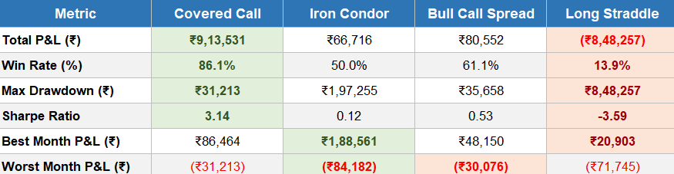
Strategy Comparison
Highest Profit: ₹9,13,531
Highest Win Rate: 86.1%
Lowest Drawdown: ₹31,213

Slide 8
Market Regime Analysis
Strategy | Trending Up | Trending Down | Sideways
Covered Call | ✓ | ✗ | ✓
Bull Call Spread | ✓✓ | ✗ | ✓
Iron Condor | ✗ | ✗ | ✓✓
Long Straddle | ✓ | ✓ | ✗
Covered Call → Bullish Bull
Call Spread → Strong Bullish Iron Condor → Sideways
Long Straddle → High Volatility

Slide 9
Which Strategy Should Be Used?
If market is Trending Up
Bull Call Spread
If market is Sideways
Iron Condor
If market is Highly Volatile
Long Straddle
If investor already owns BankNifty ETF/Futures
Covered Call
Bullish
Bull Call Spread
Sideways
Iron Condor
Volatile
Long Straddle
Own Asset
Covered Call

Slide 10
Conclusion & Future Work
Key Findings
Multiple strategies outperform under different market regimes.
No single strategy is optimal for all market conditions.
Regime-based strategy selection improves decision-making.
Future Enhancements
Add stop-loss and take-profit rules
Include transaction costs and slippage
Optimize strike selection
Incorporate machine learning for regime prediction
Extend backtesting to Nifty and FinNifty
"The best options strategy depends not only on market direction but also on prevailing market regime and volatility."

